Slide 1
STORY

Slide 2
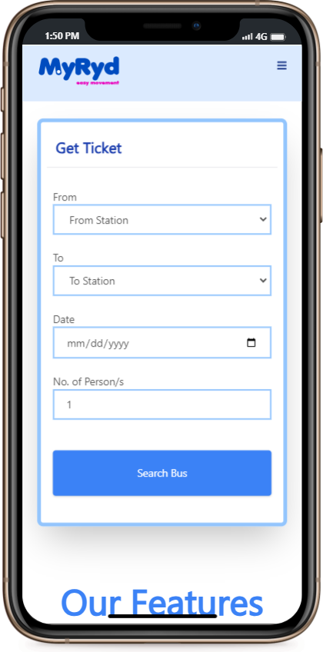
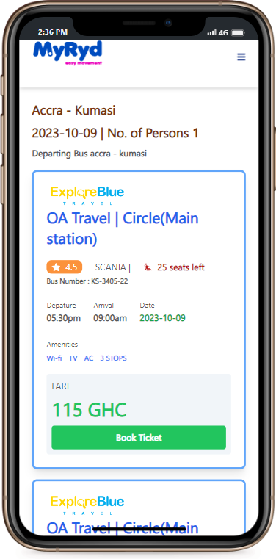
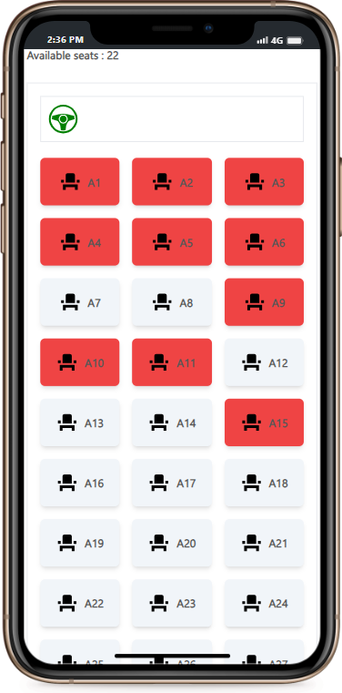
Myryd
Making Bus Ticketing Hassle-Free and Convenient

Slide 3
PROBLEM
Traditional bus ticketing processes are time-consuming, inconvenient, and often lead to confusion for travelers.
Challenges:
Long queues at ticket counters
Limited availability of preferred seats
Lack of real-time price information
Difficulty in comparing different bus services

Slide 4
SOLUTION
Introducing Myryd a user-friendly bus ticketing app designed to simplify the entire ticket booking process.
Features:
Real-time Price Information
Desired Seat Selection
Multiple Bus Options
Secure Payments
Real time notification
Desired Pick Up Location

Slide 5
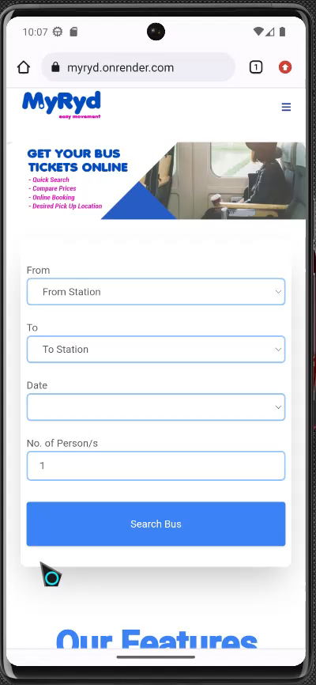

Slide 6
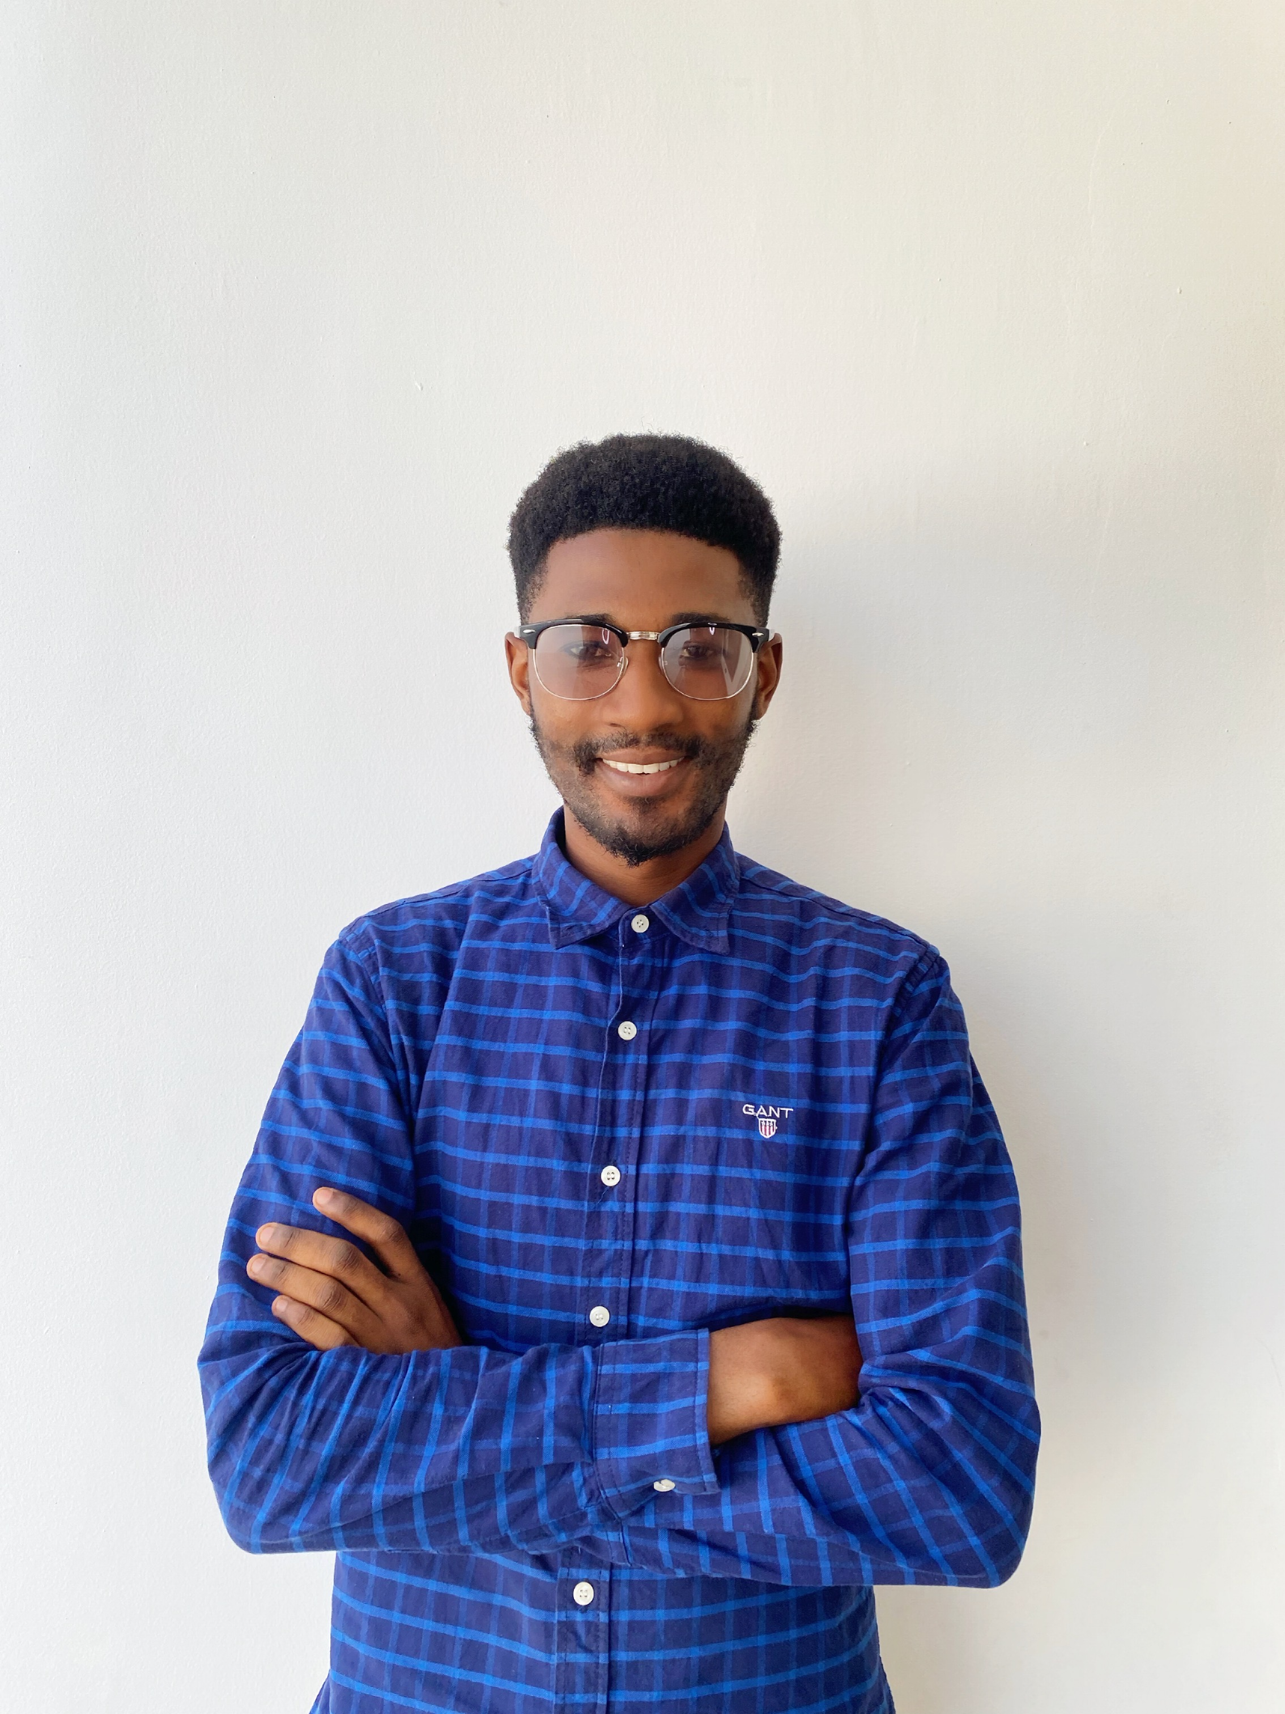
Faisal Salifu
Full stack developer

